Slide 1

VaxRisk: Analysis of VAERS Reports for Vaccine Safety Assessment
DATA 606 Capstone in Data Science
Under the guidance: Ozgur Ozturk
Chandrikarani Vaidya
Sai Ganesh Donka
Terala Bhuvana Chandrika

Slide 2

TABLE OF CONTENTS
Introduction
Background
Data Description
Exploratory Data Analysis and Data engineering
Project Scope

Slide 3

INTRODUCTION
In an era of heightened focus on public health and vaccine safety, our project aims to analyze and predict Adverse Events (AEs) associated with vaccines using data from the Vaccine Adverse Event Reporting System (VAERS). Our primary goal is to develop a model that predicts the risk of AEs and create a tool to help users assess vaccine safety.
What is an Adverse Event (AE)? An Adverse Event is a harmful or unintended outcome that occurs after a patient receives medical care, including vaccination. AEs can range from mild (e.g., soreness at injection site) to severe (e.g., anaphylaxis).

Slide 4
Project Rationale
Vaccines are crucial for public health, but no vaccine is entirely risk-free
01
Understanding which vaccines cause more severe reactions for certain individuals is vital to minimize risk and improve patient safety. This project is timely, given the increased focus on vaccination safety during the COVID-19 pandemic.
02
This research is particularly relevant given the increased focus on vaccination safety during the COVID-19 pandemic and the ongoing need for effective, safe immunization programs.
03

Slide 5
Research Question and Hypothesis
Can we predict whether a vaccine will cause a serious adverse event based on patient demographics, health history, and symptoms?
Certain vaccines have a higher likelihood of causing serious adverse reactions in patients with specific characteristics, and this risk can be predicted using machine learning models.

Slide 6

Motivation Behind the study
Over 1 million COVID-19 vaccine injuries have been reported, highlighting the need to identify factors contributing to adverse outcomes.
Serious adverse events (AEs), though rare, can lead to severe complications include severe allergic reactions, seizures, and life-threatening complications.
A CDC investigation into the Janssen vaccine revealed higher rates of fainting, emphasizing the importance of monitoring vaccine recipients.

Slide 7
Overview of similar approaches
1. State of the Art
Existing Studies: There has been extensive research on vaccine safety, focusing on adverse events reported in the VAERS database. Studies have used machine learning to predict serious vs. non-serious outcomes, but most focus on one specific vaccine or short-term side effects.
VAERS Monitoring Tools: The CDC and FDA already use data mining techniques to detect safety signals, but these models are general and not tailored to individual patient characteristics.
2. What’s Missing?
Personalized Prediction: Most existing approaches do not tailor predictions to specific individuals based on their demographics and medical history. There is also limited focus on predicting future risks for patients considering vaccination.

Slide 8
introduction to Dataset
Data source: VAERS data link
Dataset characteristics:
It consists of 3 CSV files per year (1990-2024):
1.VAERSDATA.CSV: Contains demographic and AE information
2. VAERSVAX.CSV: Vaccine-specific data
3. VAERSSYMPTOMS.CSV: Detailed symptom information
Data volume:
The total size of the zip file is 505.96 MB.
VAERSDATA – 1418326 rows and 35 columns, VAERSSYMPTOM – 1844343 rows and 11 columns and VAERSVAX – 16008874 rows and 8 columns
Data quality considerations:
Self-reported data may include biases and inconsistencies, and not all AEs are reported to VAERS

Slide 9
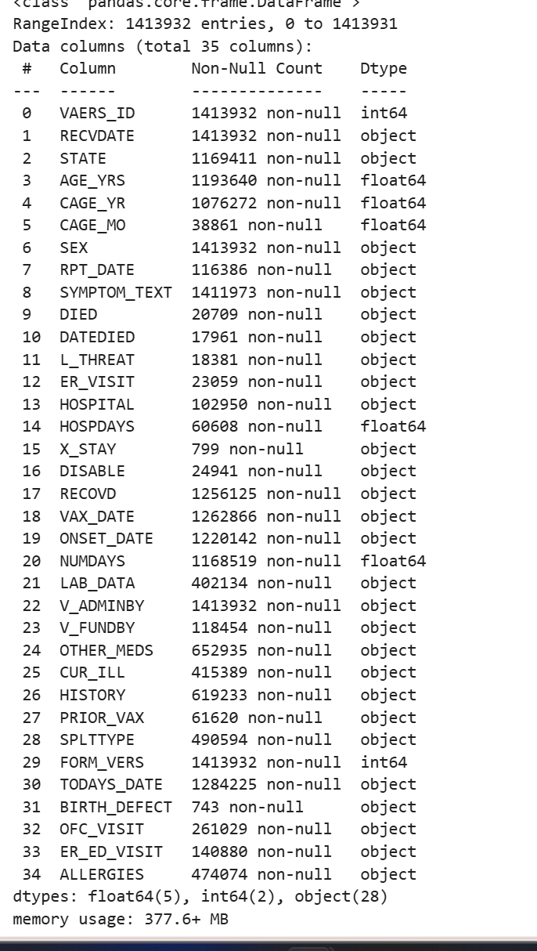
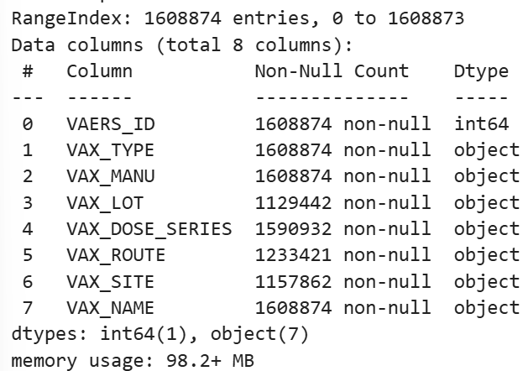
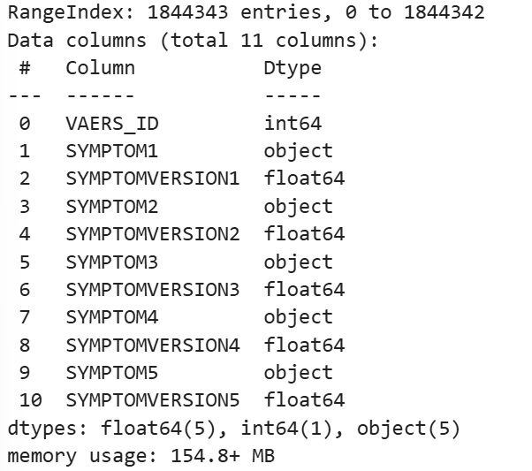
Data description

Slide 10
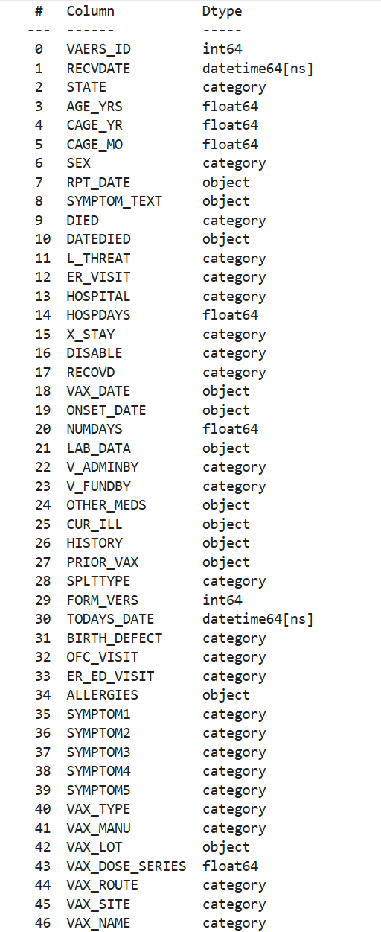
Merging Dataframes
After Merging all the dataframes from the year 2015 to 2024
total size of data is 1.3GB
It consists of total 2106687 rows and 47 columns

Slide 11
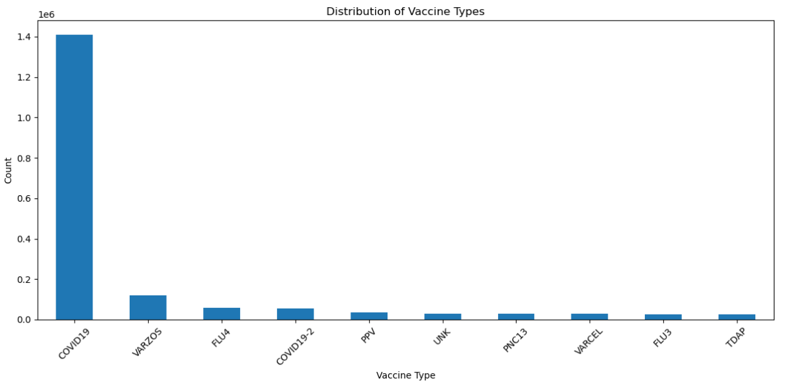
Exploratory Data Analysis
1. Understanding Vaccine type
The chart shows that COVID-19 vaccines dominate, with over 1.4 million adverse effects, far surpassing all other vaccines. VARZOS follows with much lower numbers, and vaccines like FLU3, TDAP, and VARCEL have minimal counts, highlighting the overwhelming focus on COVID-19 vaccinations.

Slide 12
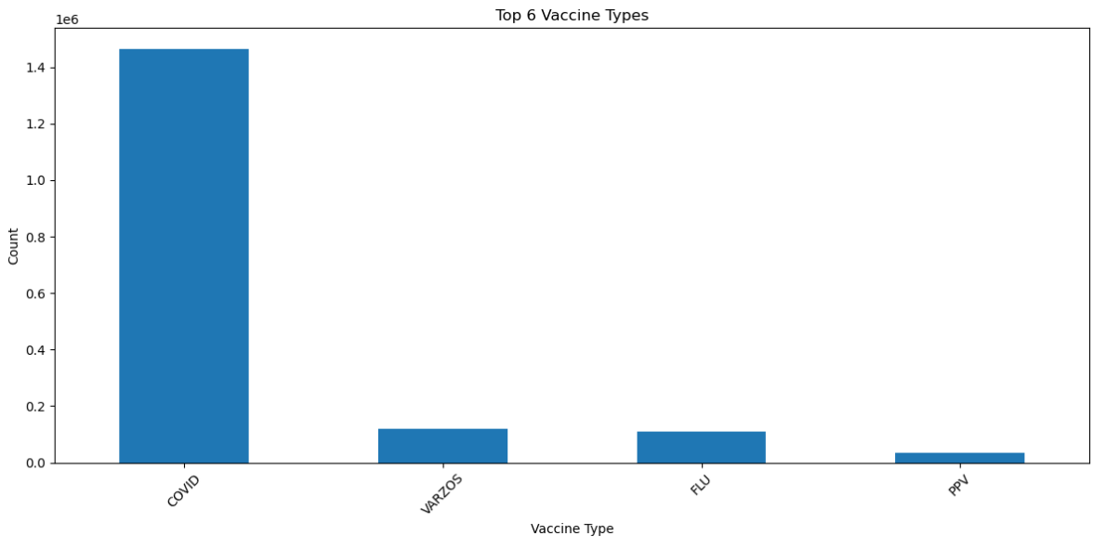
1. Understanding Vaccine type
The chart, after grouping vaccine types into broader categories like "COVID" and "FLU," highlights the top 4 vaccines with reported adverse events (AEs).
These vaccines—COVID, VARZOS, FLU, and PPV—will be the focus for further analysis, as they account for the most significant AE reports.

Slide 13
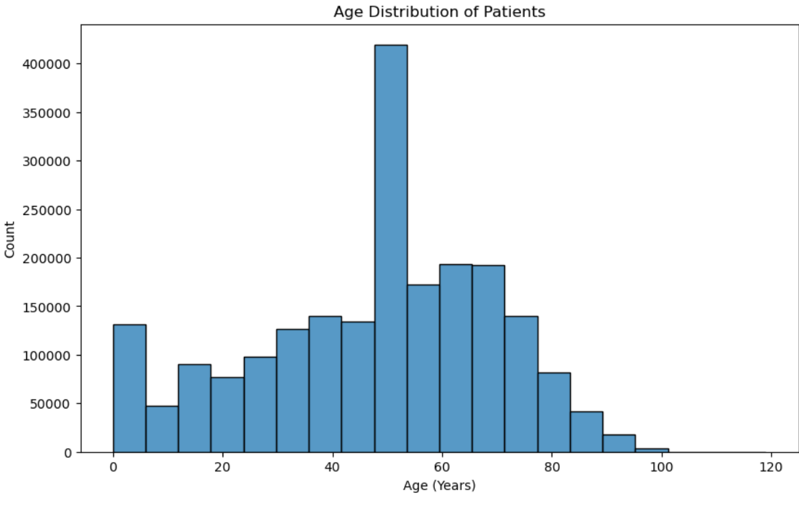
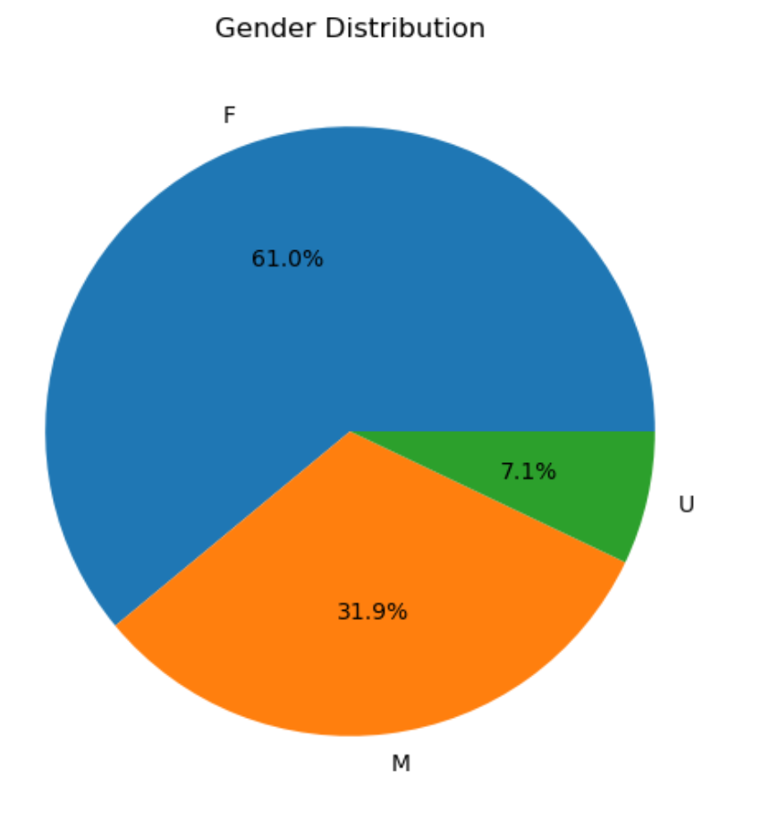
2. Understanding the demographics: Age and Gender
The histogram shows the frequency of age distribution with VAERS patient entries. It shows a peak at 50-60 stating elderly people has significant impact.
The pie chart shows that Female (F): Comprises the majority with 61.0% of the patients.Male (M): Accounts for 31.9%. Unspecified (U): Makes up 7.1%.

Slide 14
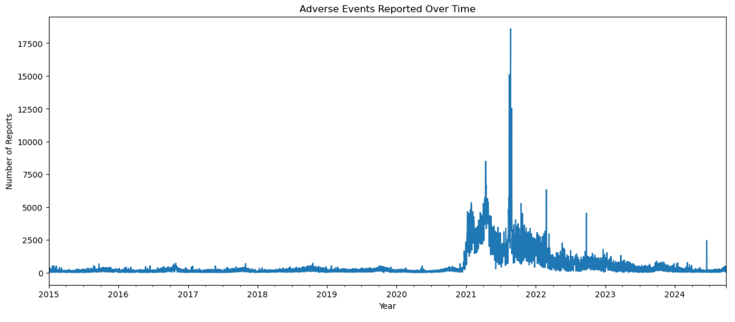
3. Understanding Adverse events over the time
A significant spike in reports is observed starting in late 2020, coinciding with the onset of the COVID-19 pandemic. This trend peaks dramatically in 2021.
After the peak in 2021, there is a gradual decline, but the number of reports remains higher than pre-pandemic levels through 2024.

Slide 15
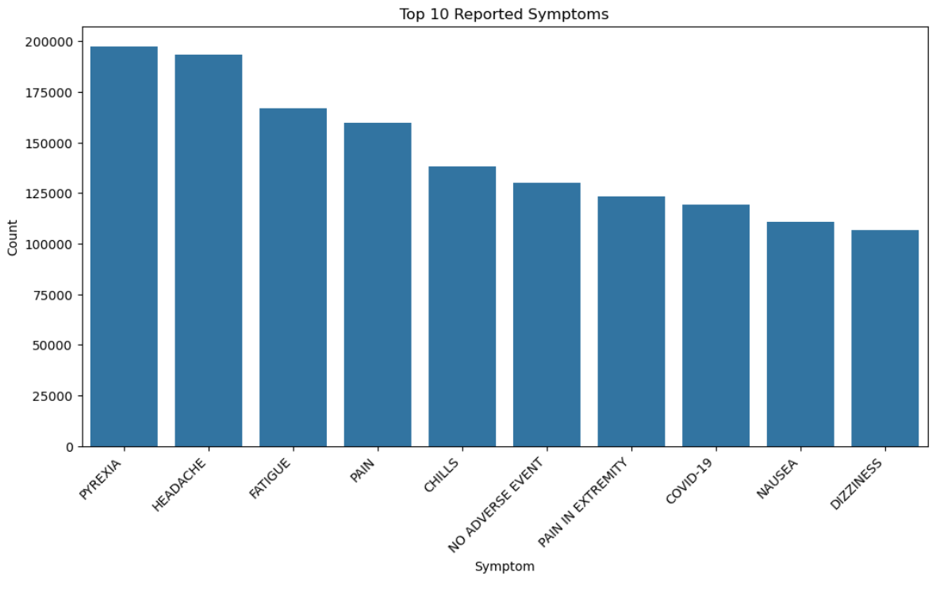
4. What are the top 10 symptoms?
From this bar graph, we see most frequently reported symptoms were pyrexia and headache. Fatigue, pain, and chills follow closely, indicating these are common adverse reactions. The graph shows top 10 Symptoms.

Slide 16
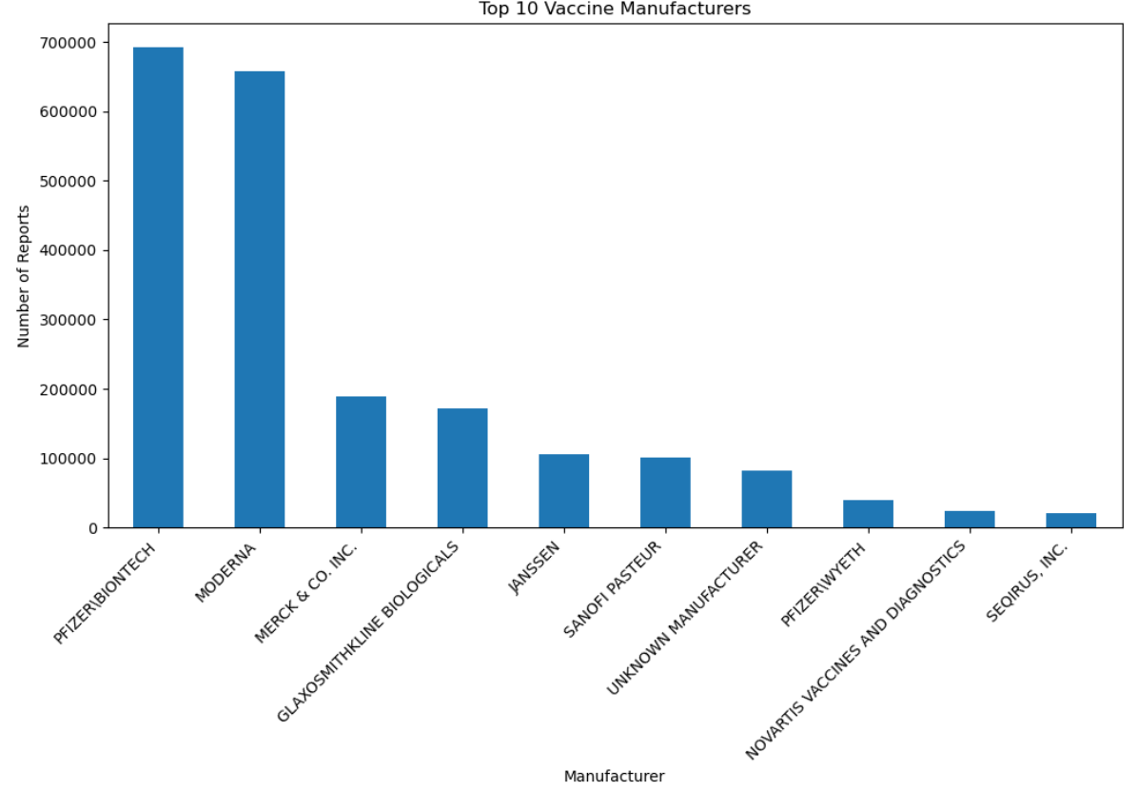
5. Top 10 Manufacturers
The plot shows the 10 vaccine manufactures using which caused adverse events.
Pfizer/BioNTech and Moderna have the highest reports, reflecting their major role in COVID-19 vaccinations.
Other manufacturers like Merck and GlaxoSmithKline also contribute significantly.

Slide 17
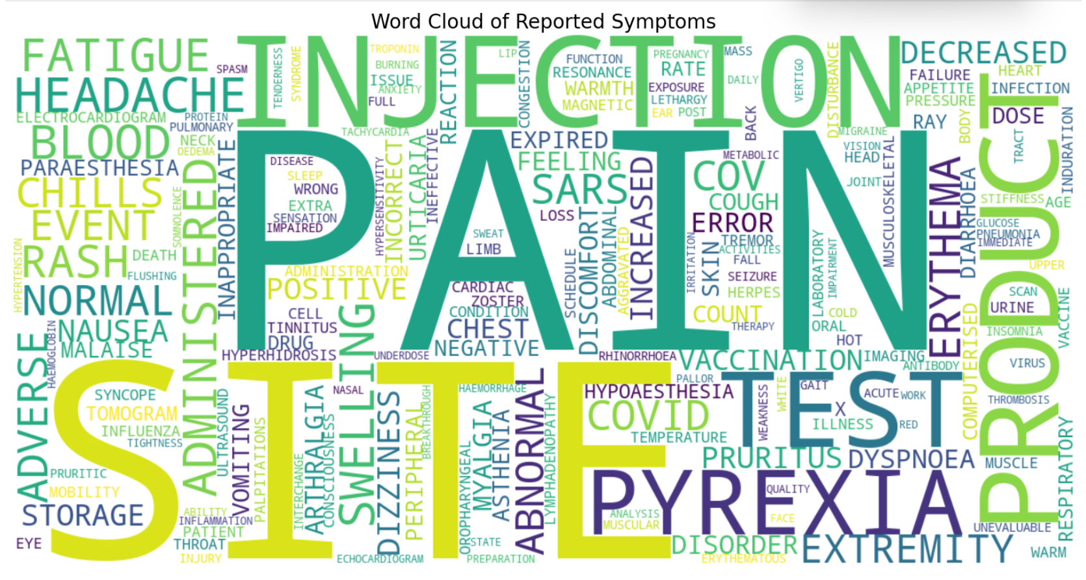

Slide 18

Data engineering
Data Preprocessing Steps
Merging the three CSV files (VAERSDATA, VAERSVAX, VAERSSYMPTOMS) for each year
Handling missing values and data inconsistencies
Encoding categorical variables (e.g., vaccine types, symptoms)
Feature engineering: Creating age groups

Slide 19
Project Scope
Vaccines Considered: COVID-19, Varicella-Zoster (VARZOS), Pneumococcal vaccine polyvalent (PPV), and Influenza (FLU) vaccines.
Problem: Predicting the risk of serious AEs based on patient demographics, symptoms, and health history. Developing insights to identify which vaccines are safer for different patient profiles.

Slide 20
Vaccine Considered
COVID vaccine that Acute respiratory illness in humans caused by a coronavirus, capable of producing severe symptoms.
VARICELLA-ZOSTER VACCINE (VARZOS): Vaccine that reduces the incidence of herpes zoster (shingles), a disease caused by reactivation of the varicella-zoster virus (VZV), which is also responsible for chickenpox.
FLU (Influenza) vaccine protects against FLU and from its potential serious complications.
PPV vaccine protects against infections like pneumonia and meningitis caused by Streptococcus pneumoniae bacteria, especially in older adults and those with weakened immune systems.

Slide 21

Thank you

